Slide 1


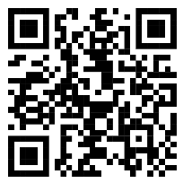
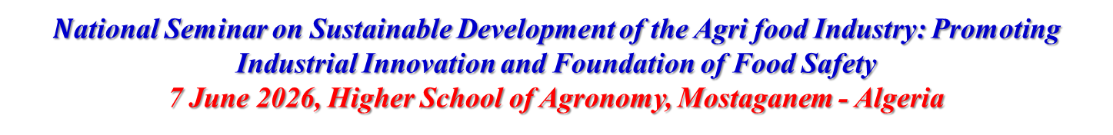
$N$ational Seminar on Sustainable Development of the Agri food Industry: Promoting Industrial Innovation and Foundation of Food Safety
7 June 2026, Higher School of Agronomy, Mostaganem - Algeria
Logo of your Lab or your University
Title of your communication
90%
Authors name
Affiliation

Slide 2

𝑵ational Seminar on Sustainable Development of the Agri food Industry: Promoting Industrial Innovation and Foundation of Food Safety
7 June 2026, Higher School of Agronomy, Mostaganem - Algeria
INTRODUCTION
Text: justified, single spaced, Times new roman (24).
90%

Slide 3


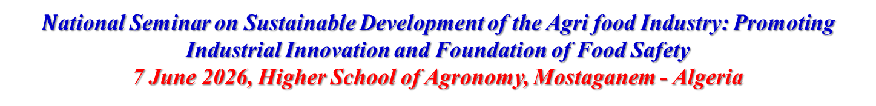
$N$ational Seminar on Sustainable Development of the Agri food Industry: Promoting Industrial Innovation and Foundation of Food Safety
7 June 2026, Higher School of Agronomy, Mostaganem - Algeria
MATERIAL AND METHODS
Text: justified, single spaced, Times new roman (24).

Slide 4

𝑵ational Seminar on Sustainable Development of the Agri food Industry: Promoting Industrial Innovation and Foundation of Food Safety
7 June 2026, Higher School of Agronomy, Mostaganem - Algeria
MATERIALS and METHODS
Text: justified, single spaced, Times new roman (24).

Slide 5

𝑵ational Seminar on Sustainable Development of the Agri food Industry: Promoting Industrial Innovation and Foundation of Food Safety
7 June 2026, Higher School of Agronomy, Mostaganem - Algeria
Results and Discussion
Text: justified, single spaced, Times new roman (24).

Slide 6

𝑵ational Seminar on Sustainable Development of the Agri food Industry: Promoting Industrial Innovation and Foundation of Food Safety
7 June 2026, Higher School of Agronomy, Mostaganem - Algeria
Results and Discussion
Text: justified, single spaced, Times new roman (24).

Slide 7
𝑵ational Seminar on Sustainable Development of the Agri food Industry: Promoting Industrial Innovation and Foundation of Food Safety
7 June 2026, Higher School of Agronomy, Mostaganem - Algeria
Results and Discussion
Text: justified, single spaced, Times new roman (24).

Slide 8
𝑵ational Seminar on Sustainable Development of the Agri food Industry: Promoting Industrial Innovation and Foundation of Food Safety
7 June 2026, Higher School of Agronomy, Mostaganem - Algeria
CONCLUSION AND PERSPECTIVES
Text: justified, single spaced, Times new roman (24).

